Slide 1
Hybrid Model of Convolutional LSTM and CNN to Predict Particulate Matter
Presented by lee seonggu
Sungkyunkwan University (SKKU), Korea
Notes:
Hello
In this time, I’ll talk about Particulate Matter Prediction using Basic Convolutional LSTM Model.

Slide 2
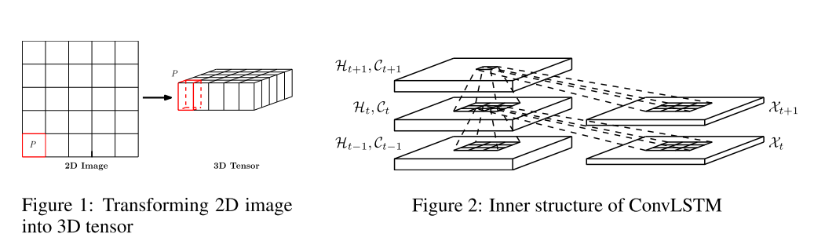
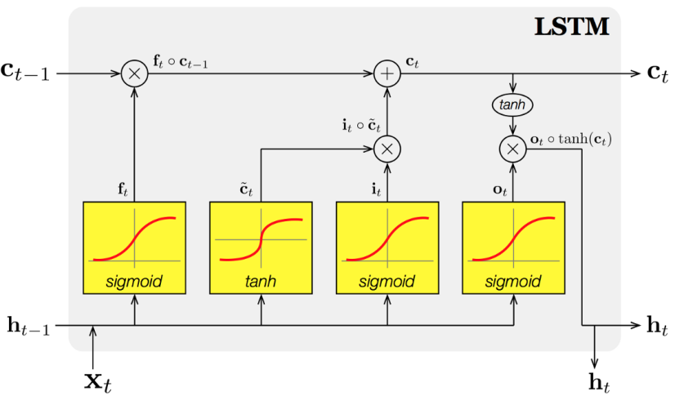
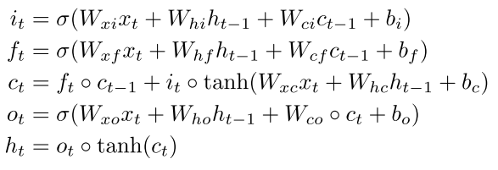
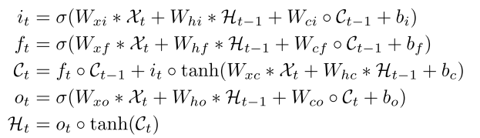
Convolutional-LSTM
Convolutional-LSTM
Extract important Spatial + Temporal feature
LSTM
Convolutional LSTM
LSTM cell structure
Notes:
Main concept of this project is Convolutional-LSTM.
As I said, LSTM is used to predict time series data.
there are cell state and 3 kind of gate to predict much longer data then RNN.
But, It can not catpure spatial data well.
It is because input data format have to be unfold 1D vector. So all the spatial information will be lost During this process
Convolutional LSTM can capture spatial feature well by using 3D input tensor that contain spatial information.
And This model replace hamard operator on LSTM equation to convolution operator to get spaital feature.

Slide 3
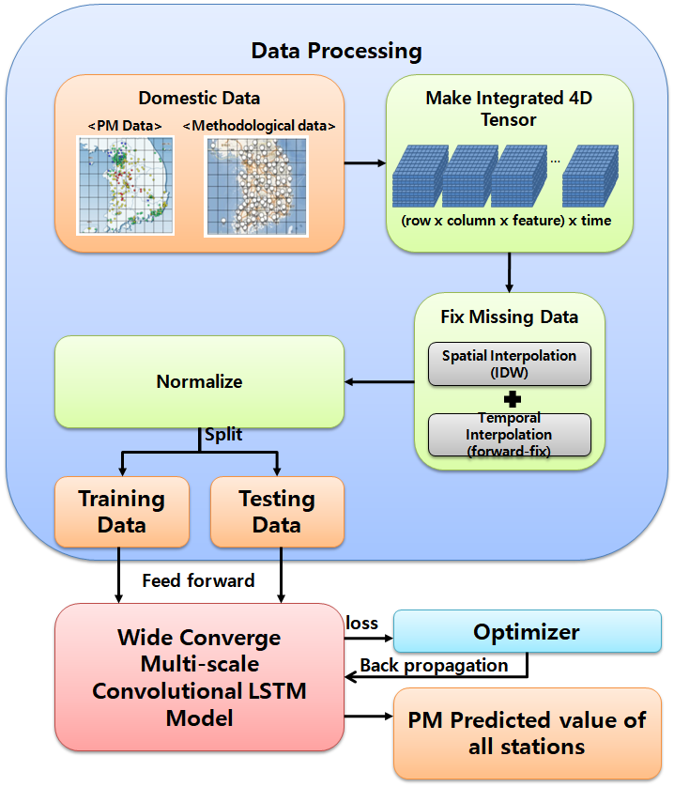
Overview
ALL Process
Dataset : Use Korea particulate matter and methodological data in wide coverage.
Pre-processing : Change the raw data format to 4D tensor(3D+ Time series) to apply this on Convolutional LSTM.
Fix missing data:
Use combination method of IDW(Inversed Distance Weight) and Forward-fix.
Model training and testing : Use Convolutional LSTM model.
Notes:
And I introduce my project process overview.
Used dataset is Korea particulate matter and methodological data in wide coverage, not just local city.
And the raw dataset will be pre-processed to apply this data on Convolutional LSTM.
After that. Some missing data are fixed by using combination method of IDW and Forward-fix
Then data-processing is complete,
Using This processed data, training and testing Convolutional LSTM model will be done to get
PM predicted value of all stations.

Slide 4
Dataset
Region
Gyeonggi, Incheon, Seoul
Period
2014.1.1 1:00 – 2015.12.31 24:00 (Training Set) & 2016.1.1 1:00 – 2016.12.31 24:00 (Testing Set)
Input Parameters | Unit | Source
Past 48-h PM10 concentration | ug/m³ | 91 of PM10 stations
Past 48-h Temperature | ℃ | 8 of methodological stations
Past 48-h Humid | % | 8 of methodological stations
Past 48-h Vapor Pressure | hPa | 8 of methodological stations
Past 48-h Wind sin component | m/s | 8 of methodological stations
Past 48-h Wind cos component | m/s | 8 of methodological stations
Output Parameters
Next 4-h PM10 concentration | ug/m³ | 91 of PM10 stations
Training and testing in terms of time series.
Past 48-h dataset
Next 4-h dataset
unused
1st Window
 |  | …
2nd Window
 |  | …
3rd Window
 |  | …
Notes:
This is table of input and output dataset.
all data are from Gyeonggi, Incheon, Seoul stations.
The measurement period is 3 year.
First and second year data are used to training set.
And third year data is used to test set.
Dataset consist of 6 input parameter and 1 output parameter
One input is past 48-h PM10 concentration from 91 PM stations
And the other inputs are methodological data such as Temperature humid vapor pressure, wind component from 8 stations.
output is Next 4-h PM10 concentration from 91 stations.
Procedure of training and testing is like this.
Each window use past 48-h dataset to predict next 4-h dataset.
1 cell means dataset in one time and it is 3d tensor.

Slide 5
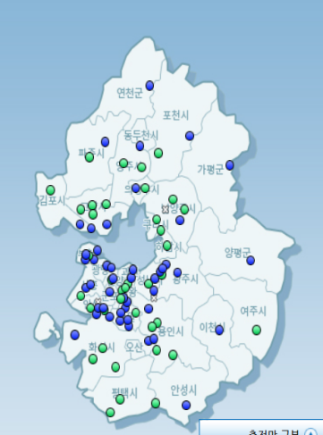
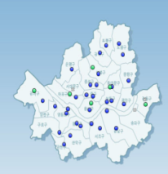
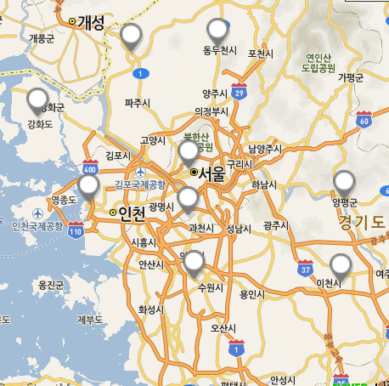
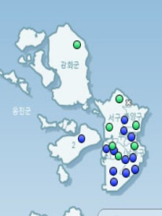
Pre-processing
Data Mapping
1. Convert latitude and longitude of stations to TM axis (x, y).
2. Scale from TM axis to matrix column and row.
for ith station,
3. Map all dataset to 3D tensors (4D tensor).
….
feature
mapping
t= n
row
t= n-1
t= 1
t= 0
column
Raw data
3D tensors
Notes:
All input dataset have to be reshaped to 4D tensor.
To do this, latitude and longitude of stations are converted to TM axis (x, y).
TM (Transverse Meractor) axis (x, y) is used on geography for Cartesian(카티션) coordinate system.
This TM axis is scaled to matrix column and row by using this equation
Then Do Mapping all dataset to 3D tensors (4D tensor).

Slide 6
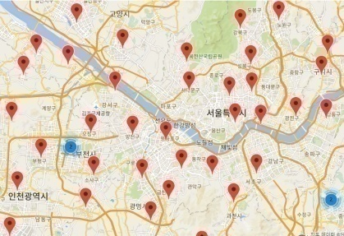
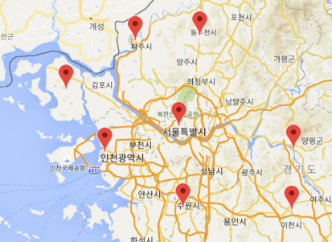
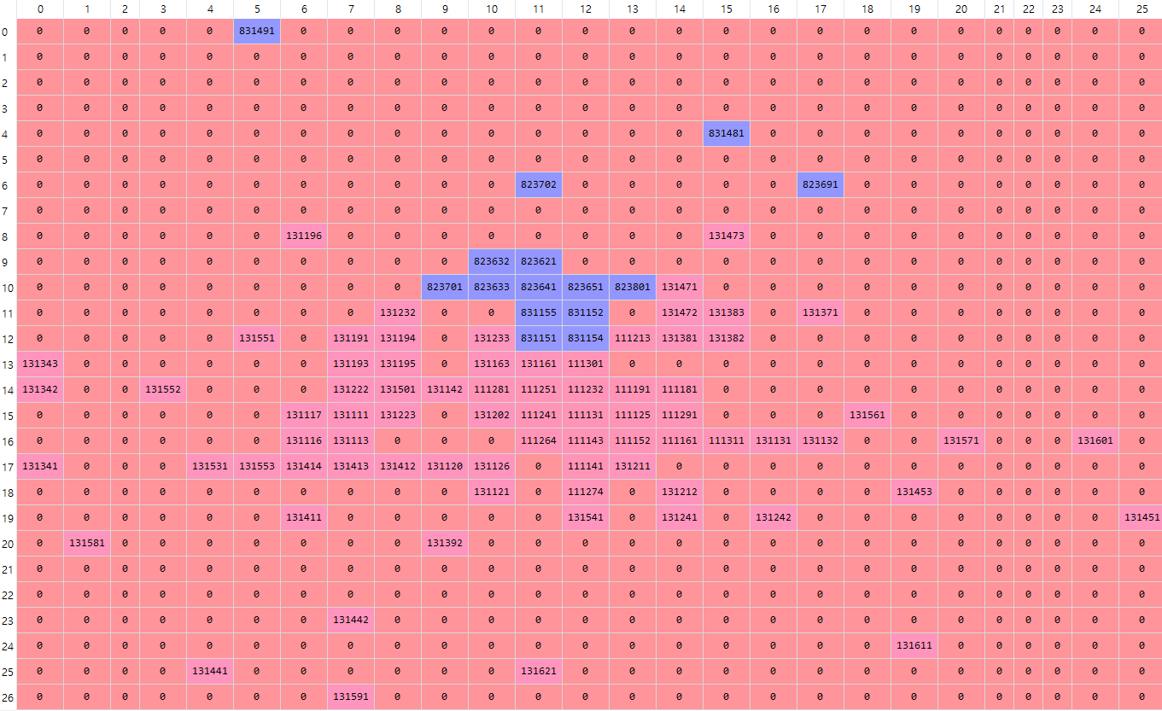
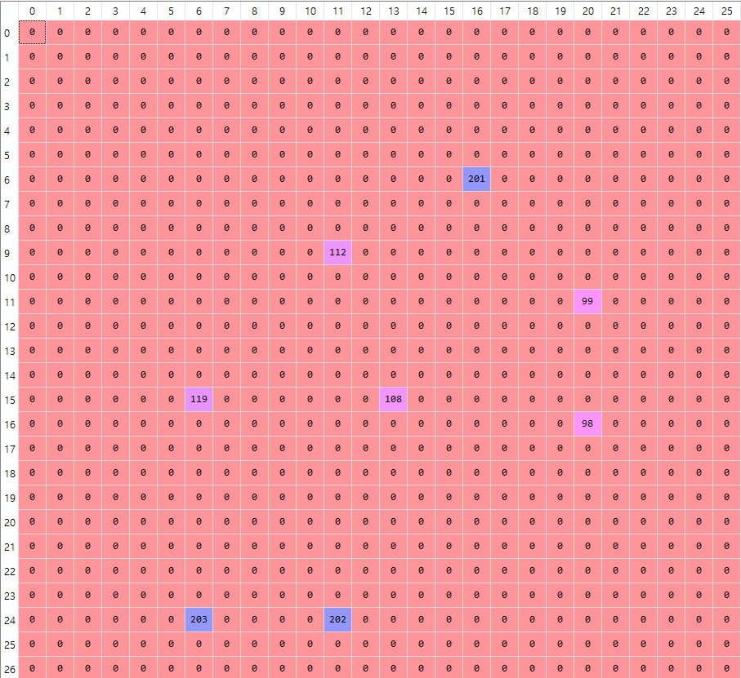
Fixing missing data
Why do we have to fix missing data correctly?
1. There are a lot of missing data on dataset because of many reasons (such as failure of measuring or network).
So depending on how to fix, wrong training can occur.
2. Especially on Convolutional LSTM model, which all data have to be mapped on 3d tensor. But, spatial distribution between methodological stations and PM stations is different, so some cell can have partial missing feature.
Raw data
Notes:
After that, We need to fix missing data.
The first reason to fix missing data is
to train model more correctly.
Especially, Second reason is only applied on Convolutional LSTM model, which all data have to be mapped on 3d tensor.
spatial distribution between methodological stations and PM stations is different, so some cell can have partial missing feature.
For example one of cell contain PM concentration but don’t contain methodological data.
Because only PM station is located on the cell.

Slide 7
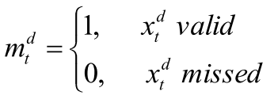
Fixing missing data
Temporal Fixing (Forward-fix)
- Replace missing value with latest valid data on own station.
for data at time t,
when t’ is the latest observed time and
- But if time interval (t- t’) is bigger, the fixing error can be bigger.
Spatial Fixing (Inverse Distance Weighting, IDW-fix)
Replace missing value with weight average of near station’s data.
for data at time t, when
- But some station can have outstanding measured data, compared to near stations.
Notes:
Generally, There are 2 kind of methods to fix missing data.
First is Temporal Fixing, Especially forward-fix.
This method replace missing value with latest valid data on own station.
This is equation of forward-fix. It is really simple.
If the measured data is invaild, the data become last latest valid data.
But if time interval (t- t’) is bigger, the fixing error can be bigger.
Second is Spatial Fixing Especially , Inverse Distance Weighting.
This method replace missing value with weight average of near station’s data
This is equation of IDW-fix and
R denoted IDW estimated value at time t and
It is calculated by this equation.
P denoted measured value on other station, D is distance between station of estimated value
And other station.But some station can have outstanding measured data, compared to near stations.

Slide 8
Fixing missing data
Spatiotemporal Fixing
Combine two methods (forward-fix and IDW)
for data at time t,
and weight in range of
when time interval
- So if the time interval is bigger, the fixed value will be more influenced by IDW than by forward-fix. It means that both of fixing methods complement each other.
Notes:
To solve those problem,
Spatiotemporal Fixing method is introduced on this project.
It is Combination of two methods which I said.
(This is equation.)
This term is from forward-fix, and This term is from IDW
The weight of the equation is like this.
If time interval between lastest valid data and missing data is bigger, weight is smaller
Then the fixed value will be more influenced by IDW than by forward-fix.
It means that both of spatial fixing method and temporal fixing method complement each other.

Slide 9
ConvLSTM Model
Input : 4D tensor
(48 input-timestep, row, column, feature)
ConvLSTM 2D layer
- 2d kernel (1x1 or 3x3 or 5x5) , 32 of Filters.
- This layer is used to encoder.
Flatten & Repeat Layer
- Reshape output of ConvLSTM to 2D tensor, (4 output-timestep, (row x column x filter) )
LSTM Layer
200 hidden state.
This layer is used to decoder.
Fully-Connected Layer
This layer add model complexity to develop
performance.
Output
- Next 4-h PM10 concentration of 91 stations
ConvLSTM Model
Input ( 48 27 x 26 x 6)
…
ConvLSTM 2D layer output : (27 x 26 x 32)
Flatten & Repeat Layer output : (4 x 22464)
LSTM Layer
output : (4 x 200)
Fully-Connected Layer output : (4 x 100)
Output
(4 x 91)
Notes:
After that, we can train and test model by using pre-processed data.
The ConvLSTM Model structure look like this
Input enter * ConvLSTM 2D layer
- 2d kernel (1x1 or 3x3 or 5x5) , 32 of Filters.
This layer is used to encoder of input dataset.
LSTM Layer
This layer is used to decoder of output dataset.

Slide 10
Other Model
CNN Model
Input : 2D tensor
(48 input-timestep, feature)
91 of PM stations data 8 of Methodological data.
raw data is same to ConvLSTM Model.
Conv 1D layer
- 1d kernel (size is 3), 32 of Filters.
This layer is used to encoder..
Fully-Connected Layer
This layer is used to decoder.
Output
- It is same to ConvLSTM Model
Input ( 48 x (91+8x5) )
Conv 1D layer output : (46 x 32)
Conv 1D layer output : (44 x 32)
Average Pooling layer
output : (22 x 32)
Flatten & Repeat Layer output : (4 x 704)
Fully-Connected Layer output : (4 x 100)
Output
(4 x 91)
Notes:
To compare result, other models have to be proposed.
First one is CNN model.
Input raw data is same to Convolutional LSTM.
But shape is different.
And This model use 1D two Convolutional Layer and one Average Pooling layer.

Slide 11
Other Model
LSTM Model
Input : 2D tensor
It is same to CNN Model.
LSTM layer (orange)
- 200 hidden state.
This layer is used to encoder.
LSTM layer (green)
- 200 hidden state.
This layer is used to decoder.
Output
- It is same to ConvLSTM Model.
Input ( 48 x (91+8x5) )
LSTM layer
output : (48 x 200)
Repeat Layer output : (4 x 200)
LSTM layer
output : (4 x 200)
Fully-Connected Layer output : (4 x 100)
Output
(4 x 91)
Notes:
Second one is LSTM model.
And This model use two LSTM Layer, one is encoder and the other is decoder.

Slide 12
Result
Compare All Model
Average RSME is derived from 91 of PM stations data.
RMSE(min), RMSE(max), RMSE(median) are derived from
three different stations which show min, max, median RMSE separately.
Convolutional LSTM Model with 3x3 kernel get the best result.
Next 4-h PM concentration prediction with 48-h input-timestep
Model (kernel size) | Average RSME | RMSE(min) | RMSE(max) | RMSE(median)
ConvLSTM (1x1) | 21.79948 | 12.9068 | 38.88621 | 20.87167
ConvLSTM (3x3) | 21.00426 | 12.69053 | 35.50324 | 19.95437
ConvLSTM (5x5) | 21.77158 | 13.56223 | 36.58099 | 21.25255
LSTM | 22.6799 | 13.72855 | 36.60621 | 21.73275
CNN (3) | 22.44803 | 14.22062 | 39.43956 | 22.0319
Notes:
I compare the result with All Model.
Average RSME is derived from 91 of PM stations data.
RMSE(min), RMSE(max), RMSE(median) are derived from
three different stations which show min, max, median RMSE separately
All Convolutional LSTM Model get better result then other model ,
Especially, Convolutional LSTM Model with 3x3 kernel get the best result.
But the result is not outstanding.

Slide 13
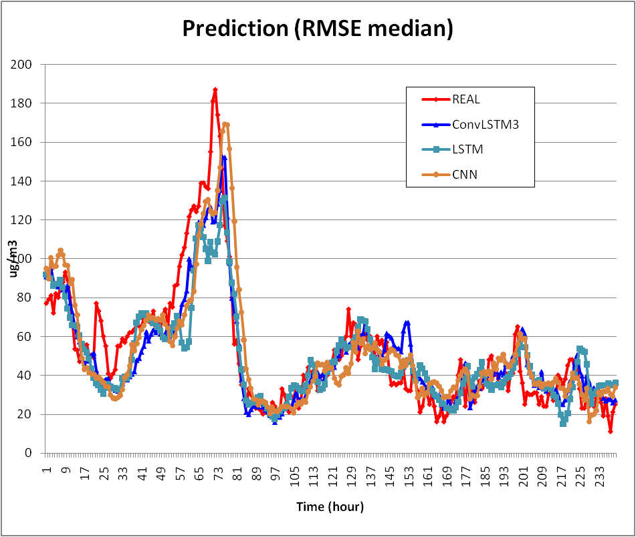
Result
Notes:
This is graph which show prediction of PM concentration from one station with median RSME.
LSTM and ConvLSTM model follow the real-value well.
CNN show some time-shift effect.

Slide 14
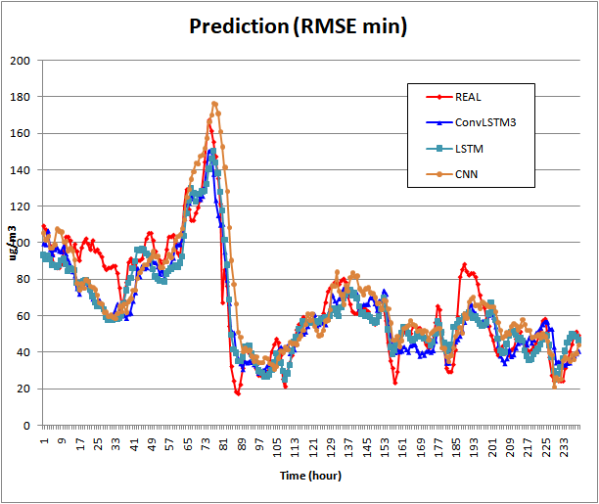
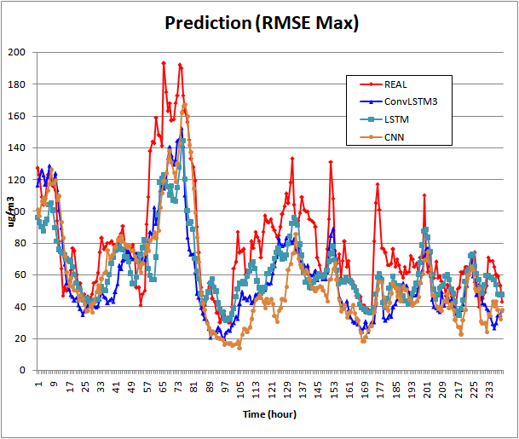
Result
Notes:
Those are graph which show prediction of PM concentration from one station with minimum, maximum RSME.
In RMSE Max graph, real value go up and down more frequently then other result.
So prediction is much harder.

Slide 15
Future work
Future work
Update Model structure and hyper-parameter.
Optimize fix- method’s weight parameter. (α and β).
Compare more Model (such as CNN-LSTM model) to verify the result.
Compare result by using different fixed dataset to verify the effect of fixing methods. (Forward-fix & IDW & IDW+ Forward-fix )
Notes:
Update Model structure and hyper-parameter.
Optimize fix- method’s weight parameter. (α and β).
Compare more Model (such as CNN-LSTM model) to verify the result.
Compare result by using different fixed dataset to verify the effect of fixing methods. (Forward-fix & IDW & IDW+ Forward-fix )

